Slide 1

EIE 2001 Basic Circuit Theory
Lecture 8
Part II. Mutual Inductance

Slide 2
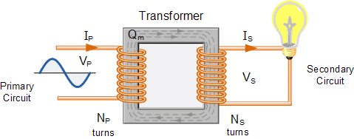
This lecture discusses mutual inductance circuits and their applications
Primary circuit and secondary circuit

Slide 3
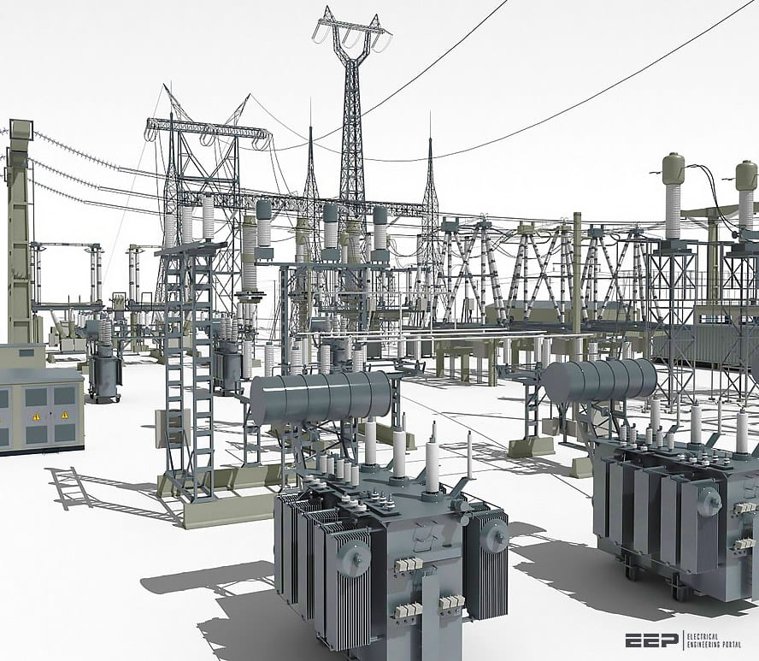
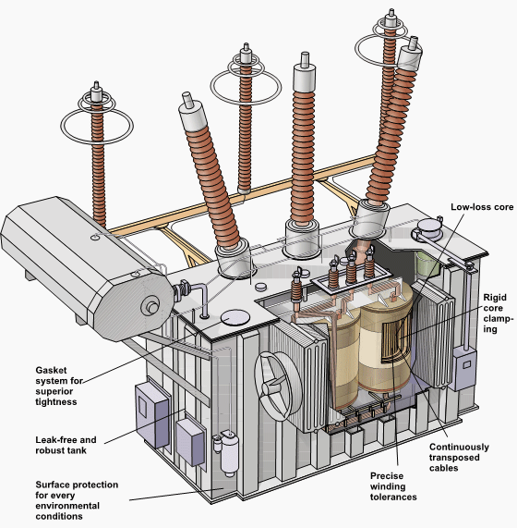
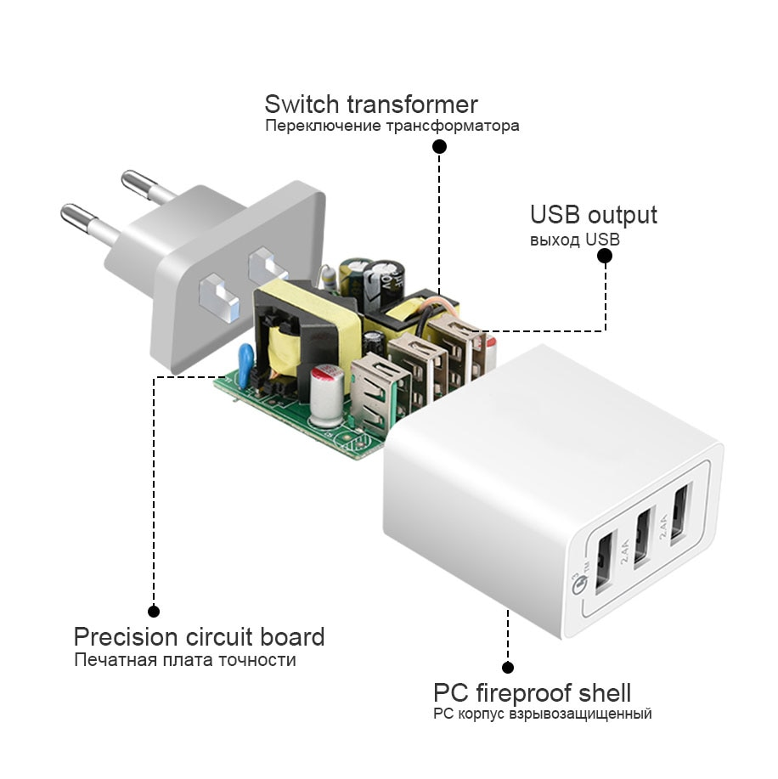
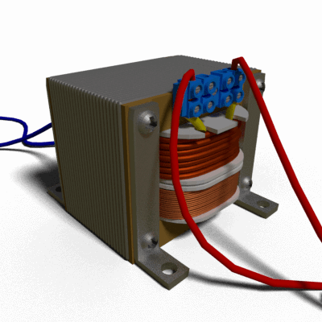
Transformers

Slide 4
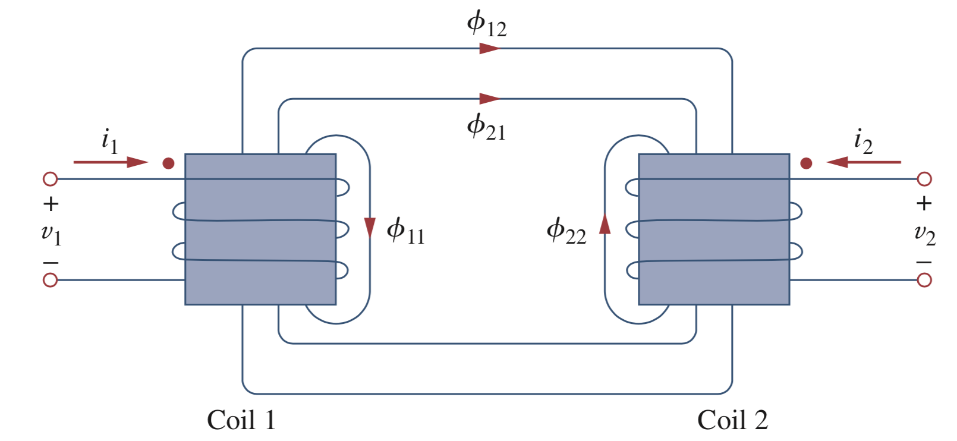



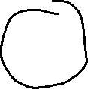
The magnetic coupling
The magnetic flux at coil 1 equals to the magnetic flux created by its own current i₁ plus the magnetic flux emanating from coil 2 in proximity from current i₂.
N₁ turns
N₂ turns
For coil 1: ，
For coil 2: ，

Slide 5
The magnetic coupling: Mutual inductance
Caution: The polarity is determined by the orientation or the particular way in which both coils are physically wound.
The dot convention in circuit analysis is a convenience notation to identify the polarity.
For coil 1:
(positive if i₂ enters to the dot)
For coil 2:
(positive if i₁ enters to the dot)
M₁₂ = M₂₁ = M in our case

Slide 6

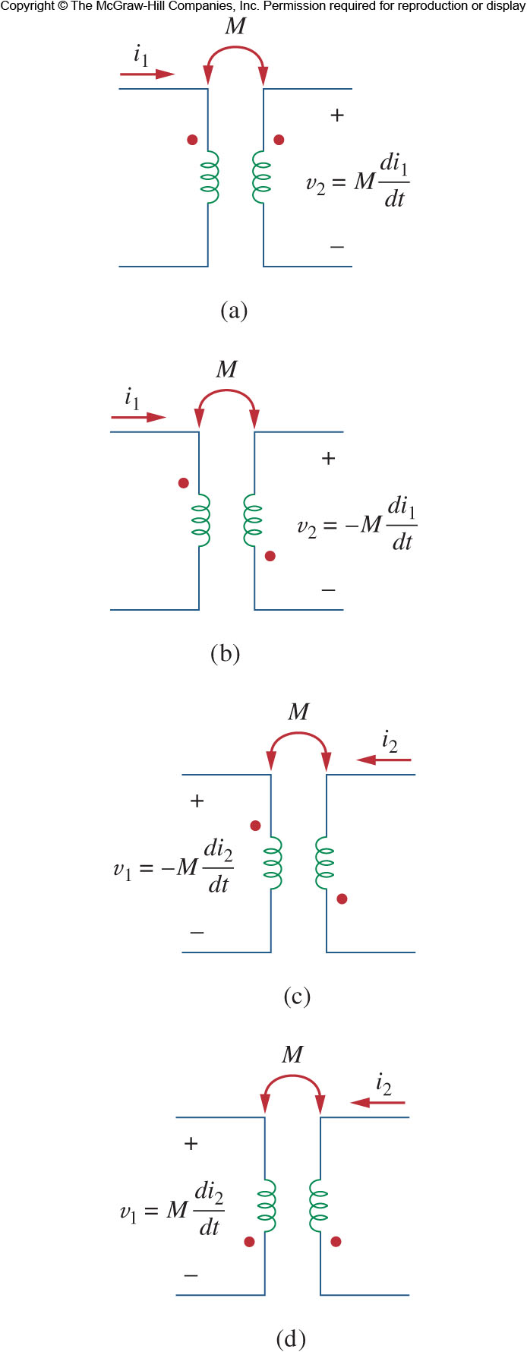
The dot convention

Slide 7
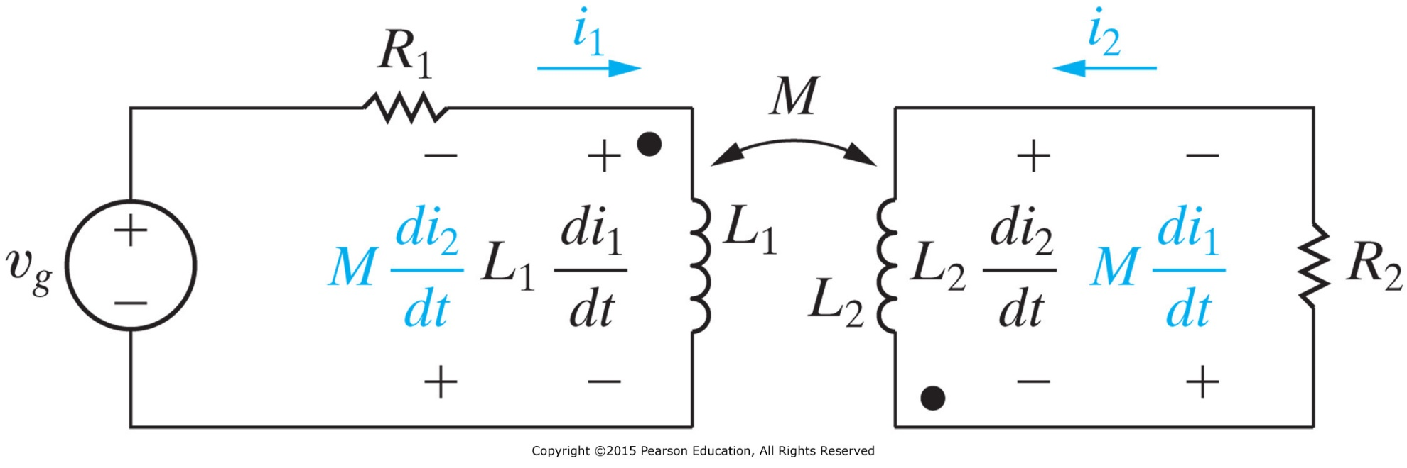
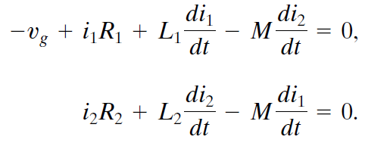
With Mutual Inductance

Slide 8



Coupling Coefficient
The mutual inductance can be related to self-inductances by using coupling coefficient k.
The coupling coefficient has a range of $0≤k≤1$
It is determined by the physical configuration of the coils.
$$M^{2}=k^{2}L_{1}L_{2}$$
$$M=k\sqrt{L_{1}L_{2}}$$

Slide 9
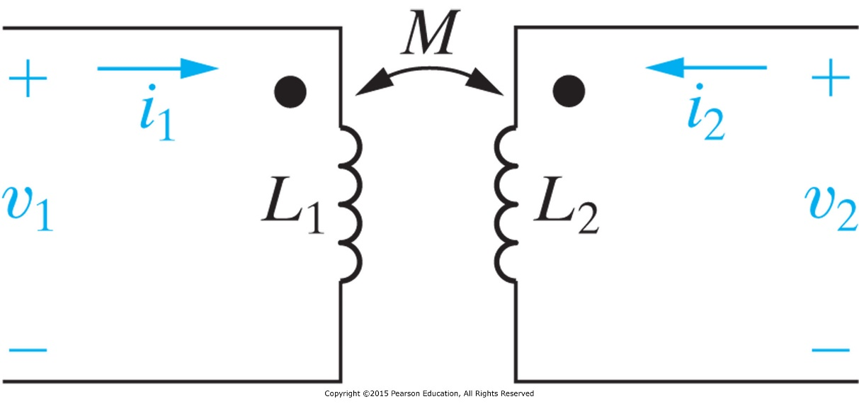
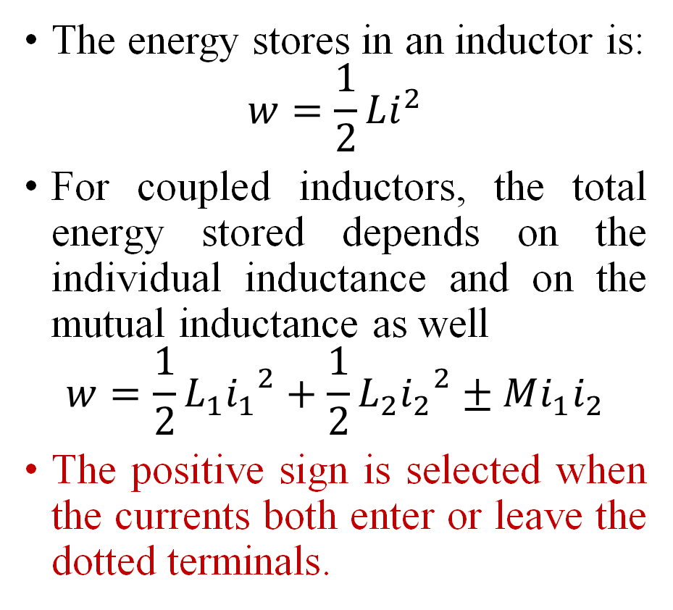
Energy Calculations
The energy stores in an inductor is:
$$w=\frac{1}{2}Li^{2}$$
For coupled inductors, the total energy stored depends on the individual inductance and on the mutual inductance as well
$$w=\frac{1}{2}L_{1}{i_{1}}^{2}+\frac{1}{2}L_{2}{i_{2}}^{2}±Mi_{1}i_{2}$$
The positive sign is selected when the currents both enter or leave the dotted terminals.

Slide 10
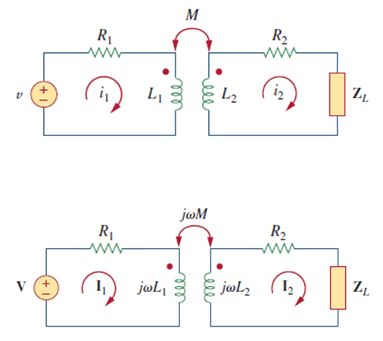

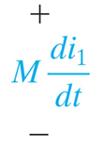


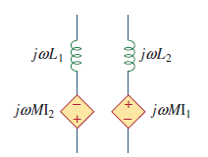
Equivalent circuits using phasors

Slide 11
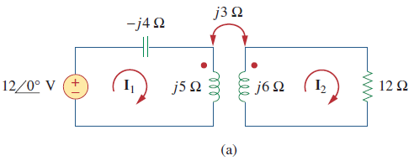



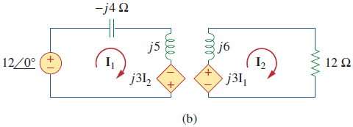

Example: Calculate the phasor currents I1 and I2 in the circuit

Slide 12
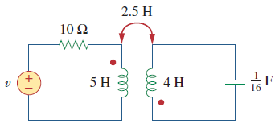

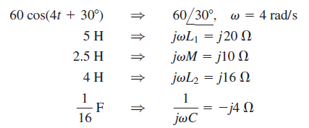
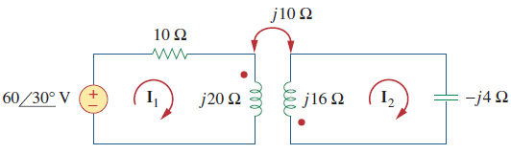
Example
(a) Determine the coupling coefficient
(b) Calculate the energy stored in the coupled inductors at t = 1 s

Slide 13
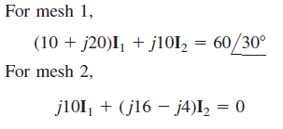
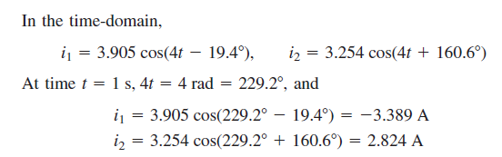


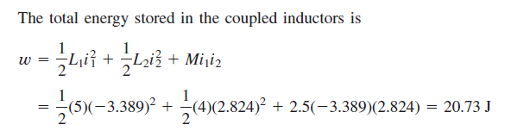

Slide 14
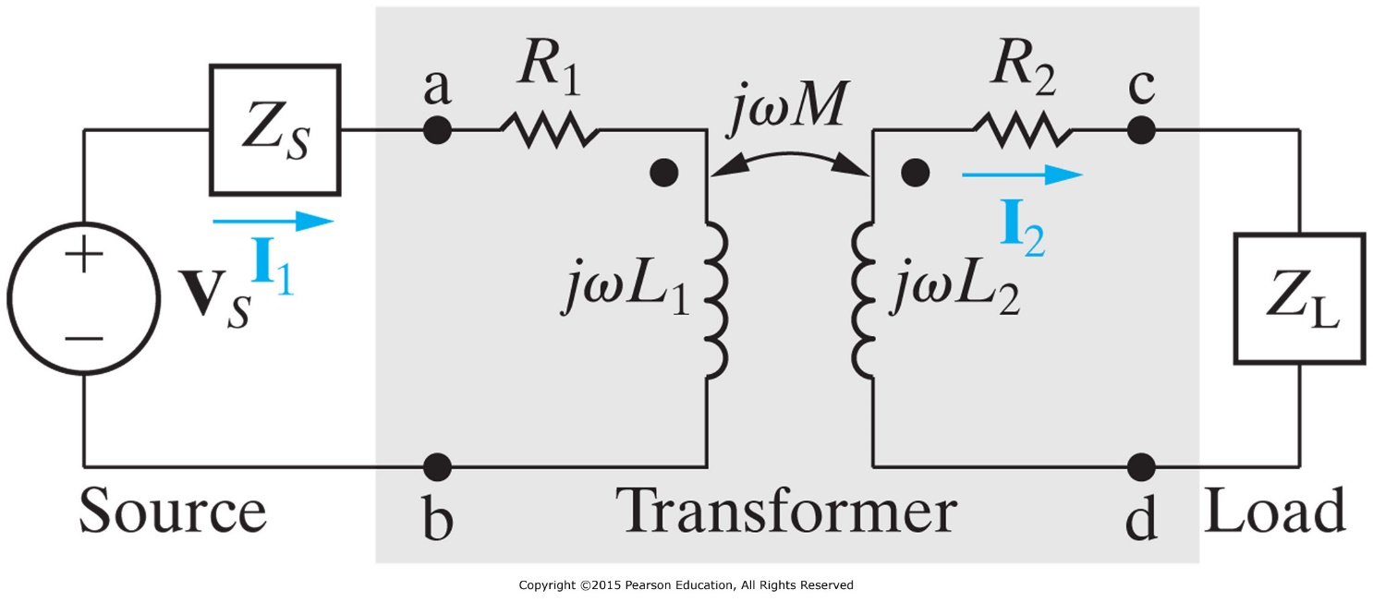
Linear Transformers as an application of mutual inductance to deliver power to a secondary circuit
A transformer is a magnetic device that takes advantage of mutual inductance
  Generally a four terminal device comprised of two or more magnetically coupled coils.
  They are called linear if the coils are wound on a magnetically linear material.
Primary Winding
Secondary Winding

Slide 15


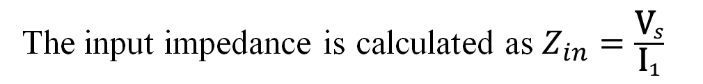
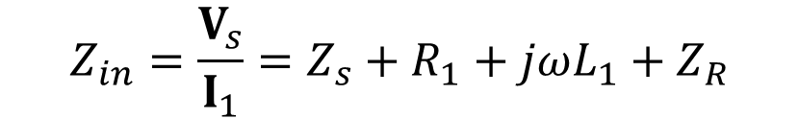
Transformer Analysis
Using these two equations, we can solve I₁ and I₂.
The input impedance is calculated as $Z_{in}=\frac{{\text{V}}_{s}}{{\text{I}}_{1}}$
$$Z_{in}=\frac{V_{s}}{I_{1}}=Z_{s}+R_{1}+jωL_{1}+Z_{R}$$
where
This is known as the reflected impedance, showing how the secondary winding impacts the input impedance of the circuit of primary winding

Slide 16

Ideal Transformers
An ideal transformer is one with perfect coupling (k=1).
It has two or more windings with a large number of turns on a core of high permeability.
The ideal transformer has:
Coils with very large reactance (L₁, L₂, M →∞)
Coupling coefficient is equal to unity.
Primary and secondary coils are lossless (R₁=R₂→0)
$$M=k\sqrt{L_{1}L_{2}}$$

Slide 17
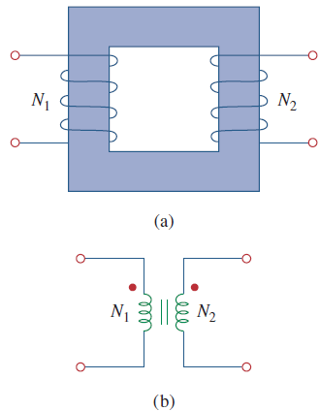
Ideal Transformers
Iron core transformers are close to ideal.
The same flux goes through both windings
The voltages are related to each other by the turns ration n:
where 1, 2 refers to the primary, secondary coil.
A step down transformer (n<1) is one whose secondary voltage is less than its primary voltage
A step up (n>1) is the opposite
From power conservation,
Circuit symbol of an iron core
transformer

Slide 18
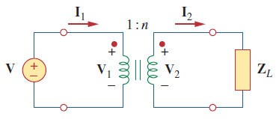
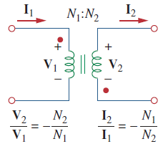
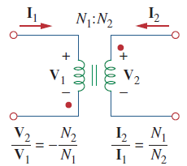
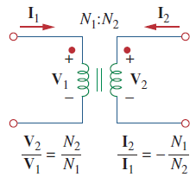
Ideal Transformers
In phasor form,
Note the direction of currents relative to the dots.
It is important to get the proper polarity of the voltages and direction of currents in different configurations.
  If V₁ and V₂ are both positive or both negative at the dotted terminals, the V₂ to V₁ ratio is +n. Otherwise, it is –n.
  If I₁and I₂ both enter into or both leave the dotted terminals, the I₂ to I₁ ratio is –1/n. Otherwise, it is +1/n
Notes:
All the polarities are to ensure that the “consumed” power at the primary coil is exactly the “consumed” power at the load.

Slide 19
Ideal Transformers
The complex power in the primary winding is:
There is no loss for the ideal transformer.
The input impedance that appears at the source is:
This is also called the reflected impedance since it appears as if the load impedance is reflected to the primary side.
This ability of the transformer to transform a given impedance into another impedance provides us a means of impedance matching to ensure maximum power transfer.

Slide 20
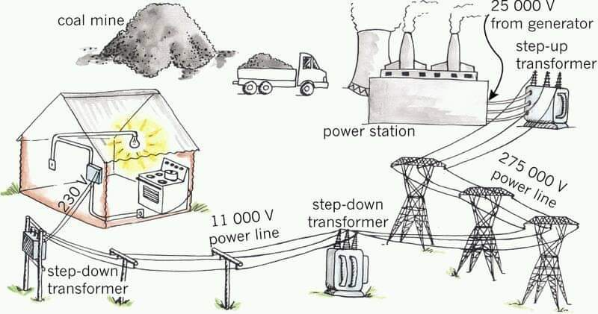
Application: power line systems
Q: Why 3 wires?

Slide 21
Three-Phase System
Nearly all electric power is generated and distributed in three-phase, at the operating frequency of 60 Hz in the United States or 50 Hz in some other parts of the world.
It is important in power system specialization but impossible to cover in one or two lecture sessions.
Here, we will only give an understanding of the steady-state sinusoidal behavior of balanced three-phase circuits.
Notes:
3 phase gives very good all-round compromise between power transmission (adding 50% extra wiring gives 200% extra power) and complexity. Another phase adds little benefit; it's still not as smooth as DC, and not much extra power.

Slide 22
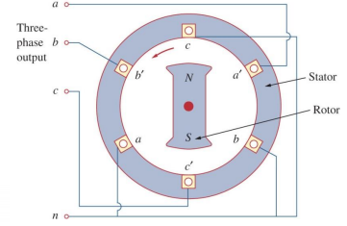
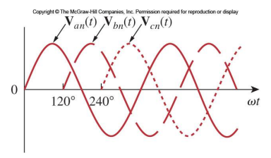
Three-Phase AC Generator

Slide 23
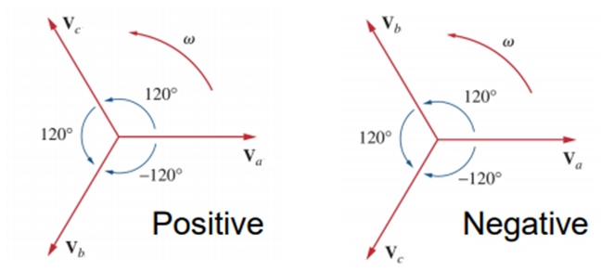
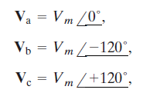
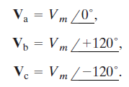

Balanced Source
$$V_{a}+V_{b}+V_{c}=0$$
A set of balanced three-phase voltages consists of three sinusoidal voltages that have identical amplitudes and frequencies but are out of phase with each other; by exactly Standard practice we refer to the three phases as a, b, and c, and use the a-phase as the reference phase. The three voltages are referred to as the a-phase voltage, the b-phase voltage, and the c-phase voltage.

Slide 24
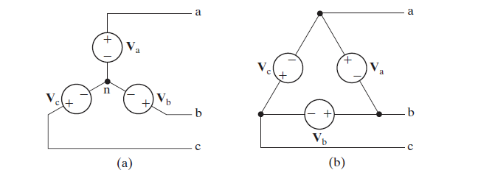


Two Basic Connections of Ideal Three-Phase Source:
Y-connection and Δ-connection
+
+
$$V_{ab}^{(Y)}=\sqrt{3}V_{a}∠{30}^{°}$$
$$V_{ab}^{(Δ)}=V_{a}$$
-
-
Y-Connected Source
Δ-Connected Source

Slide 25
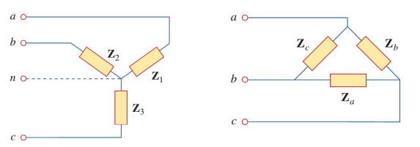


Balanced Loads
Similar to the source, a balanced load is one that has the same impedance presented to all three voltage sources. They may also be connected in either Delta or wye
The wye delta loads can be interchanged using $Z_{∆}=3Z_{Y}$ or $Z_{Y}=\frac{1}{3}{ Z}_{∆}$

Slide 26
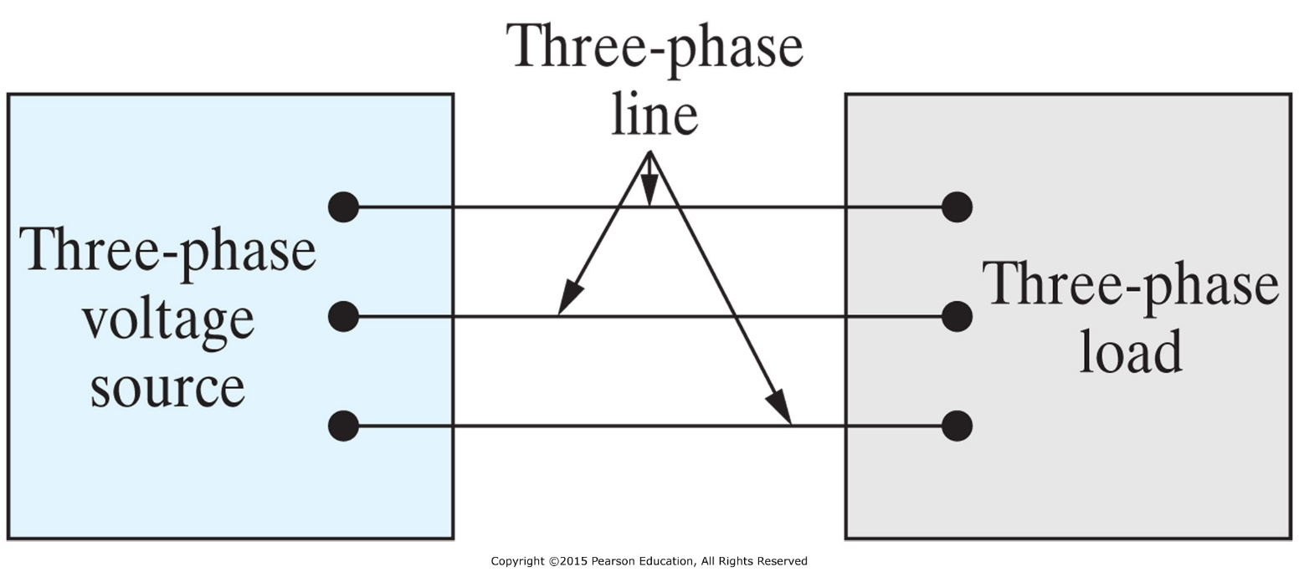
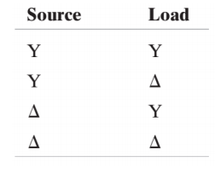
Balanced Three-Phase Voltages

Slide 27
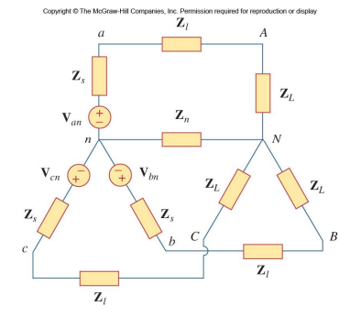


Balanced Y-Y Connection
Any three-phase system can be reduced to an equivalent Y-Y system.
We will consider an example of a balanced four wire Y-Y system shown here.
The load impedances Z_{y} will be assumed to be balanced.
  This can be the source 𝑍_{𝑠} , line 𝑍_{𝑙} and load 𝑍_{𝐿} together.

Slide 28
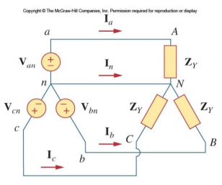

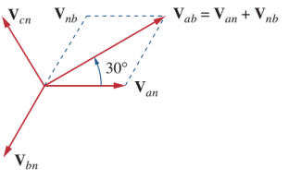
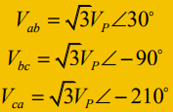

Line-to-Line Voltage
Using the positive sequence for example
The line-to-line voltage (or line voltage for short):
Thus the magnitude of the line voltages V_{L} is

Slide 29


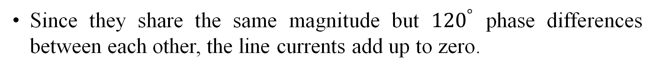
Line Currents
If we apply KVL to each phase, the line currents can be obtained:
Since they share the same magnitude but ${120}^{°}$ phase differences between each other, the line currents add up to zero.
Thus, the neutral wire has zero voltage and no current.

Slide 30
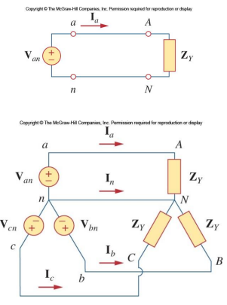

Y-Y Circuit Per Phase Analysis
An alternative way to analyze the Y-Y circuit is to look at each phase individually. Taking Phase a for example, the equivalent circuit for that phase is shown here.
The current for this phase is:
Since the circuit is balanced, only one phase need to be analyzed.

Slide 31
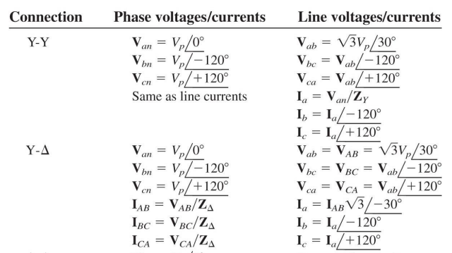
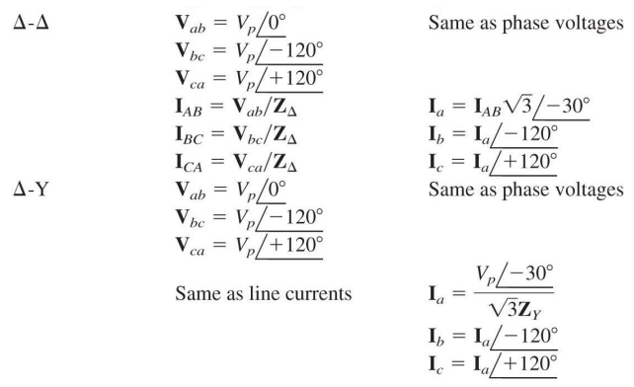
For the other configurations, we can always convert the source and load back to a Y-Y system.
Summary of Phase and Line Voltages/Currents for Balanced Three-Phase Systems

Slide 32


Slide 33
Expected learning outcome
Be able to analyze simple two part circuits coupled by mutual inductance
  Be able to formulate KVL equations for loops involving mutual inductance
  Be able to construct equivalent circuits (inductor + dependent source) to capture the effect of mutual inductance (using both time domain representation and phasor representation
Be able to calculate voltage and current conversions for ideal transformer
Understand the basic concepts of three-phase circuits
  Be able to use the balanced load and balance source concept to analyze the voltage and current in different phases.

